Slide 1
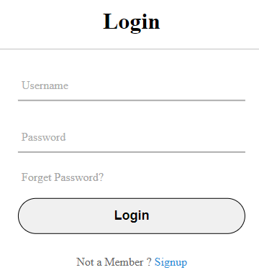
User Login
Current Vote
Log In
snipped from
https://www.codewithfaraz.com/content/6/create-a-pure-css-simple-login-page-html-and-css

Slide 2
Account creation page - all
Current Vote
Log In
First name*: ____________
Last name*: ____________
Email*: ____________
Phone: ____________
Address 1*: ____________
Address 2: ____________
City*: ____________
State/Province*: ____________
Country*: ____________
Gender: ____________
Create account
* means required for creation
Notes:
Instead of admin, users can view and can’t vote on their own poll

Slide 3
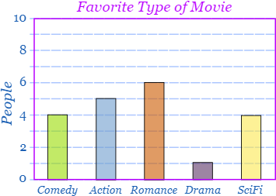
Active Votes Page - Main Page
Vote Statistics:
Started By: Prof. Muskat
Option 1: 3482 Votes (XX.X%)
Option 2: 3365 Votes (XX.X%)
Option 3: 5263 Votes (XX.X%)
Option 4: 4720 Votes (XX.X%)
Option 5: 8531 Votes (XX.X%)
!Log In Now to Vote!
www.votingsite.com
(view individual votes)
Sample graph snipped from https://www.mathsisfun.com/data/bar-graphs.html

Slide 4
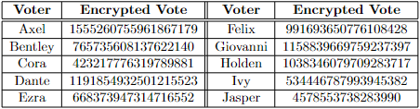
Active Votes Page - Alt Page
(view tallied votes)

Slide 5

User profile page - once logged in
Current Vote
Profile
Log Out
Willow Kxxxxx-Xxxxxx
Email: wxxxxx.xxxxxx@western.edu
Voting History:
WILL IMPLEMENT IF TIME PERMITS
Your Vote: X (37.8%)
Winner : Y (42.8%)
Profile Options:
Change PFP
Change Password
Log Out
Sample graph snipped from https://www.mathsisfun.com/data/bar-graphs.html
Notes:
Tentatively ignore this page :D

Slide 6
User profile page - General, no variant
Current Vote
Profile
Create Vote
Log Out
Willow Kxxxxx-Xxxxxx
Email: wxxxxx.xxxxxx@western.edu
Voting History:
WILL IMPLEMENT IF TIME PERMITS
Your Vote: X (37.8%)
Winner : Y (42.8%)
Profile Options:
Change PFP
Change Password
Log Out
Sample graph snipped from https://www.mathsisfun.com/data/bar-graphs.html

Slide 7
Change Password
Current Vote
Profile
Log Out
Current Password:
Confirm:
New Password:
Confirm:
Submit

Slide 8
Vote creation page - admin - once logged in
Current Vote
Profile
Create Vote
Log Out
Vote title*: ____________
Creator*: ____________
Option 1*: ____________
Option 2*: ____________
Option 3: ____________
Poll privacy*:
Allow self voting*: __________
Add Option
Private (link required)
Public (shown on current votes tab)
Yes
No
Create poll
* means required for creation

Slide 9
Voting Page
Profile
Create Vote
Log Out
Banana
Apple
Orange
Strawberry
Generate Vote
1555260755961867179

